Slide 1
Data Science Lecture 1 Introduction to Data Science: Data Source, Type, and Storage
Shuen-Lin Jeng
Dept. of Statistics and Inst. of Data Science
NCKU
2023/09/03

Slide 2
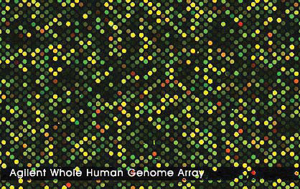

Data Source Biological Sciences
Bioimaging technology allows us to simultaneously monitor tens of thousands of genes or proteins as they are expressed differently in the tissues or cells under different experimental conditions
Gene expression profiles of microarrays. The intensity at each spot represents the gene expression profile (e.g. Agilent microarray, left panel) or relative profile (e.g. cDNA-microarray, right panel).

Slide 3
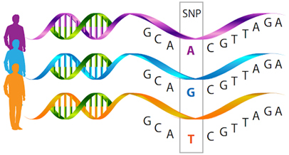
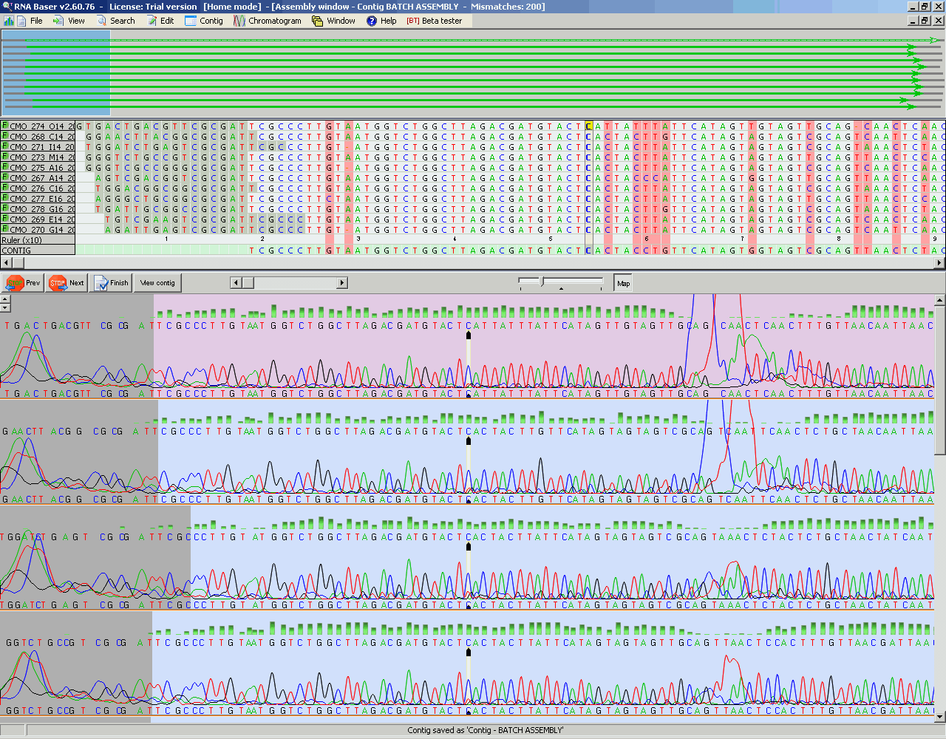
Data Source Bioinformatics: SNP

Slide 4
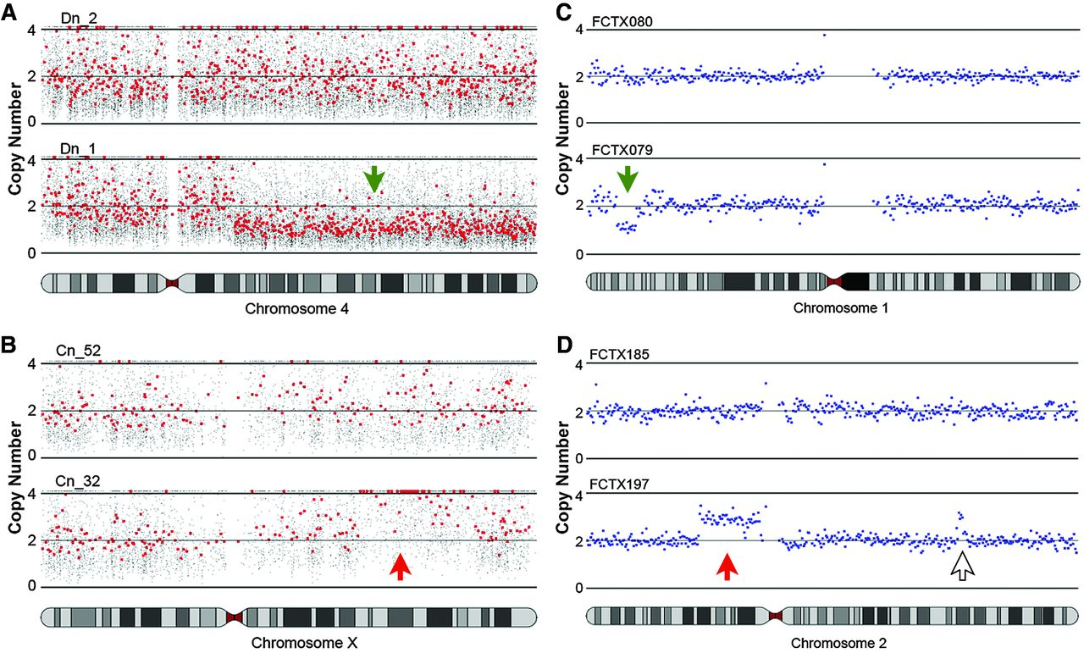
Data Source Bioinformatics: CNV

Slide 5

Data Source Bioinformatics: CNV for NIPT
https://www.stat.ncku.edu.tw/index.php?option=module&lang=cht&task=pageinfo&id=891&index=8
NIPT: https://www.medgene.com.tw/service.html

Slide 6
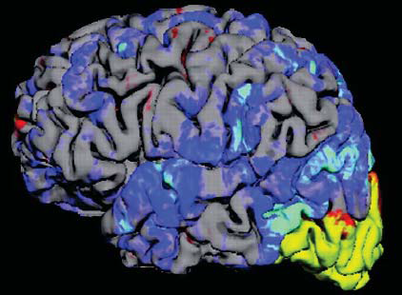
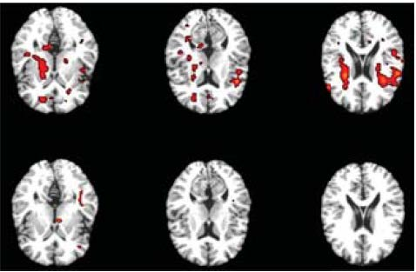
Data Source Biological Sciences: Brain
Schematic illustration of a brain response to a cognitive task and several slices of its associated fMRI measurements

Slide 7
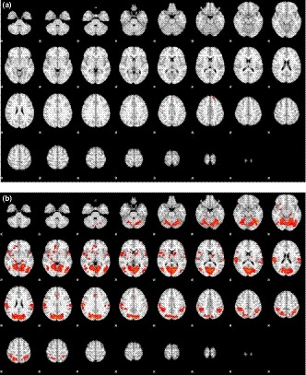

Data Source Brain and Behavior
Cerebral control of winking before and after learning: An event-related fMRI study (2019, Chou Ching K. Lin, Kuo Jung Lee, Chih Hsu Huang, Yung Nien Sun)

Slide 8
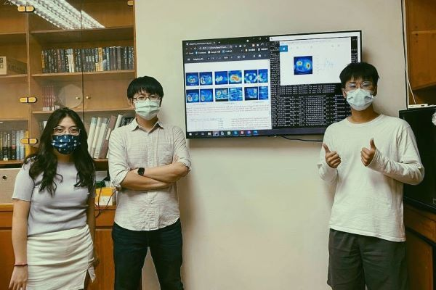
Image Processing: Lung Infection Prof. Hsu, Chih-Chung
2021 ICCV MIA-COV19D challenge，3rd place!

Slide 9
Data Source Health Sciences
A famous example is the Framingham Heart Study, initiated in 1948 and sponsored by the National Heart, Lung and Blood Institute. Documentation of its first 55 years can be found at the website
http://www.framinghamheartstudy.org/.Conclusion
In this study, there are more than 25,000 samples, each consisting of more than 100 variables. Because of the nature of this longitudinal study, some participants cannot be followed up due to their migrations. Thus, the collected data contain many missing values.

Slide 10
Health Sciences National Health Insurance Research Database
基本資料檔 Registration files
醫事機構病床主檔 Registry for contracted beds (BED)
醫事機構診療科別明細檔 Registry for contracted specialty services (DETA)
醫事機構基本資料檔 Registry for contracted medical facilities (HOSB)
醫事機構副檔資料檔 Supplementary registry for contracted medical facilities (HOSX)
專科醫師證書主檔 Registry for board-certified specialists (DOC)
醫事人員基本資料檔 Registry for medical personnel (PER)
重大傷病證明明細檔 Registry for catastrophic illness patients (HV)
醫事機構服務項目檔 Registry for medical services (HOX)
藥品主檔 Registry for drug prescriptions (DRUG)
承保資料檔 Registry for beneficiaries (ID)
原始資料檔 Original claim data
住院費用申請總表主檔 Monthly claim summary for inpatient claims (DT)
門診費用申請總表主檔 Monthly claim summary for ambulatory care claims (CT)
住院醫療費用清單明細檔 Inpatient expenditures by admissions (DD)
住院醫療費用醫令清單明細檔 Details of inpatient orders (DO)
門診處方及治療明細檔 Ambulatory care expenditures by visits (CD)
門診處方醫令明細檔 Details of ambulatory care orders (OO)
特約藥局處方及調劑明細檔 Expenditures for prescriptions dispensed at contracted

Slide 11
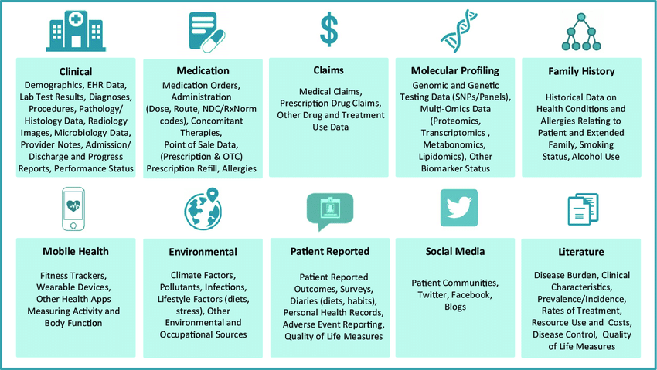
Data Source Medical Data

Slide 12
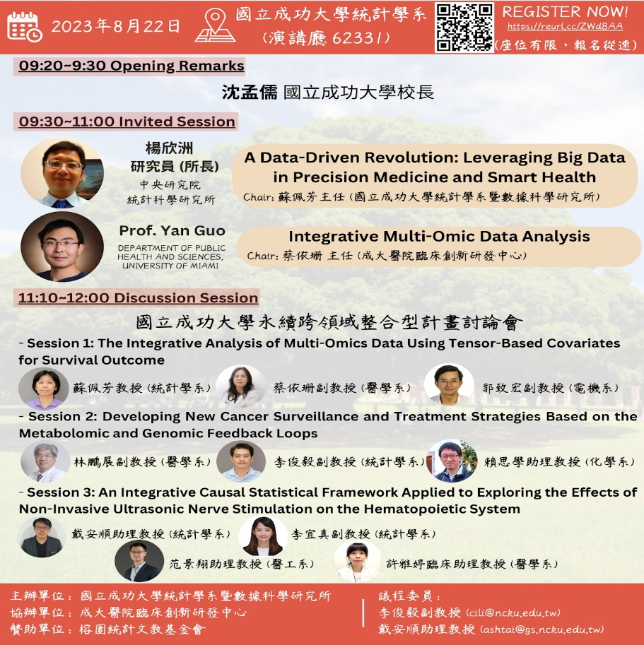
Data Source Medical Data

Slide 13
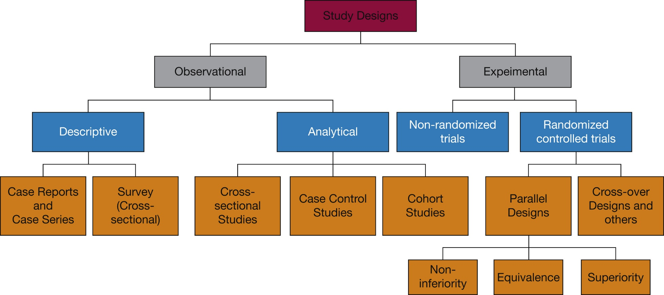
Clinical Research and More: Study Design

Slide 14
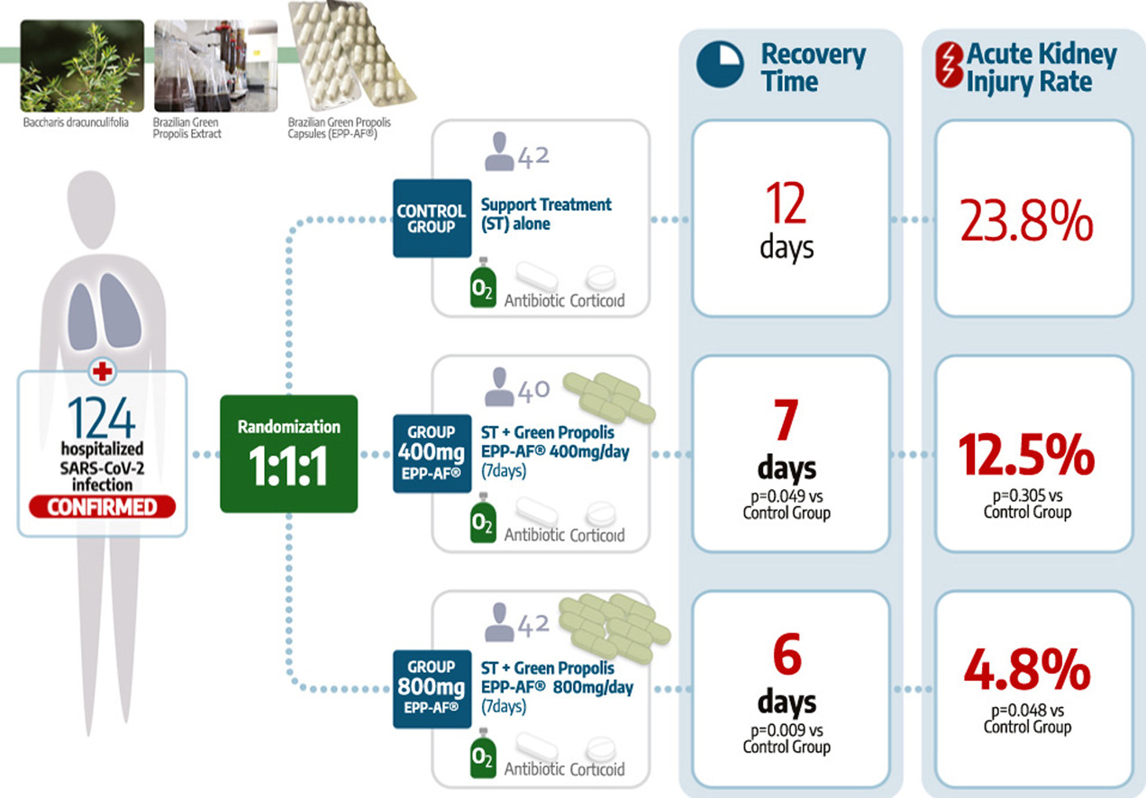
Data Source Health Sciences Treatment Experiment

Slide 15
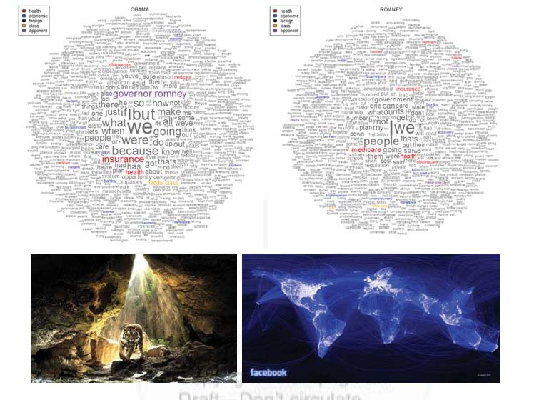
Data Source Computer and Information Sciences
Top panel: the word clouds of 2012 U.S. presidential debates (Left: President Obama; Right: GovernerRomney).
Bottom left: It is challenging for computer to recognize the tiger from the background in computer vision.
Bottom right: Visualization of the friendship connection in Facebook on December 2010

Slide 16

Deep Learning, Social Networks, Graph Computing, Recommender Systems, and Natural Language Processing. Prof. Li, Cheng-Te

Slide 17
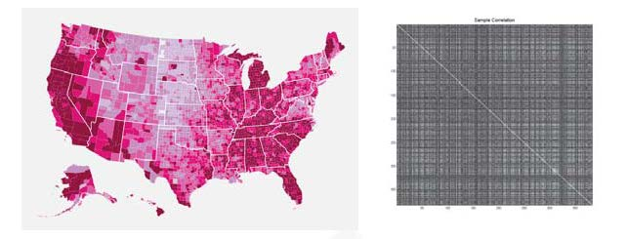
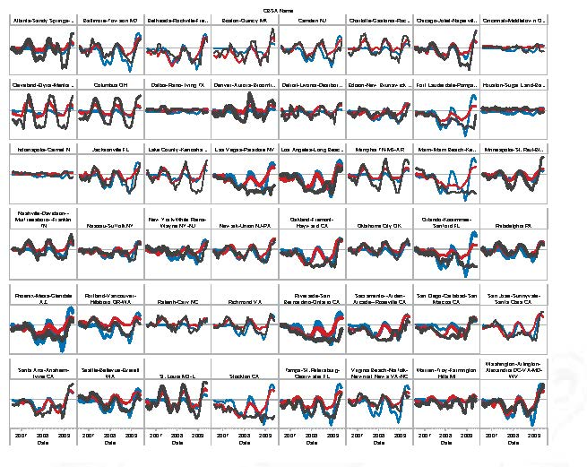
Data Source Economics and Finance
Prediction of monthly housing appreciation. Top panel-left: Choropleth map for the 2009 U.S. unemployment rate by county. Top panel-right: Spatial correlation of monthly housing price appreciation among 352 largest counties in the United States from January 2000 to December 2009
Right panel: Prediction of monthly housing pricing appreciation in 48 regions from January 2006 to December 2009 using a large
sparse econometrics model with 352 monthly time series from January 2000 to December 2005. Blue: OLS. Red: PLS. Black: Acutal. Thickness: Proportion
to repeated sales. Adapted from Fan, Lv, and Qi (2012).

Slide 18
Data Source Financial Technology

Slide 19

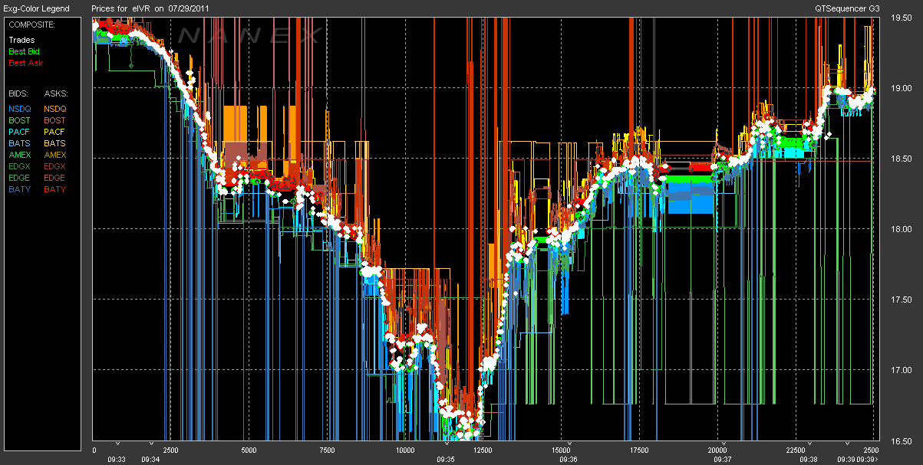
Data Source High-Frequency Stock Price

Slide 20
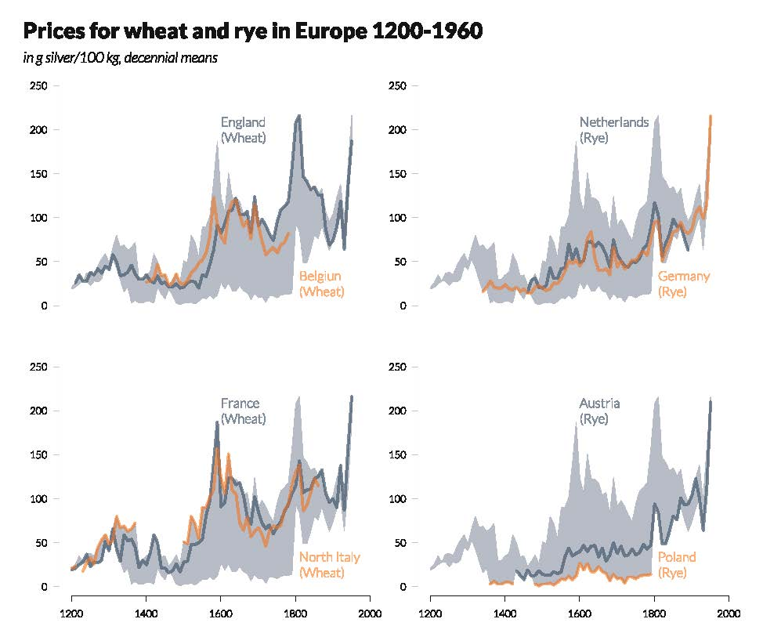
Data Source Economics Prices for Wheat and Rye

Slide 21
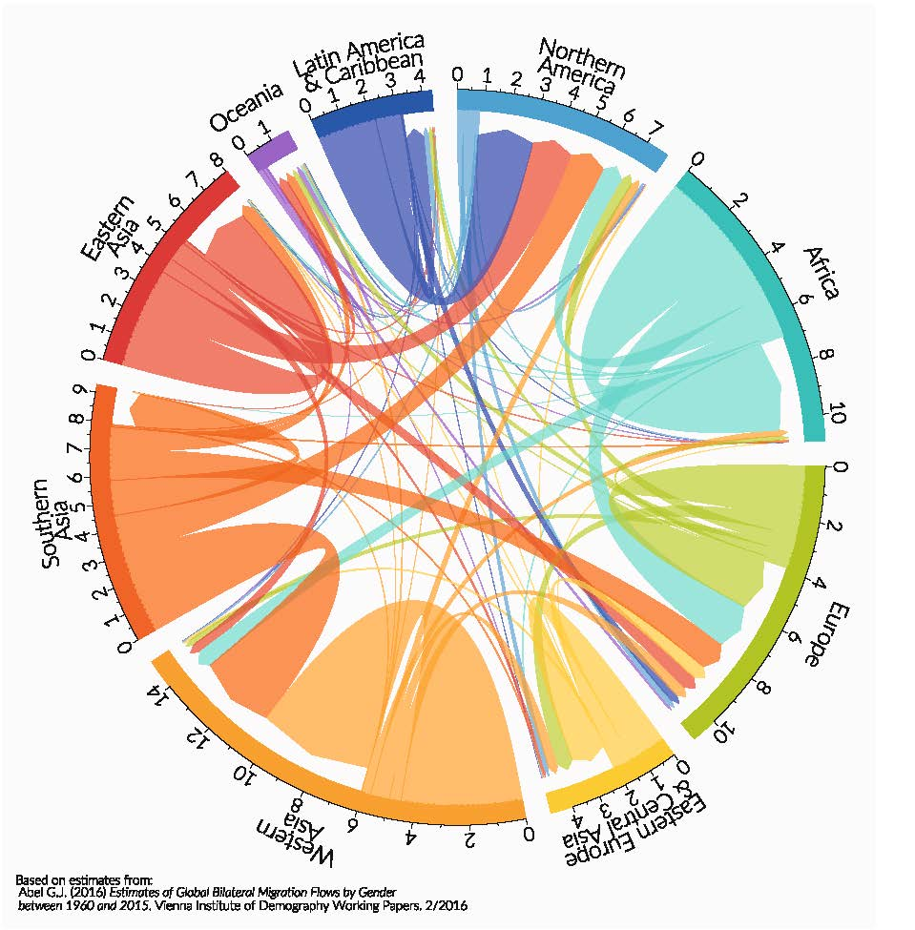
Data Science Social Science Migration Flows

Slide 22
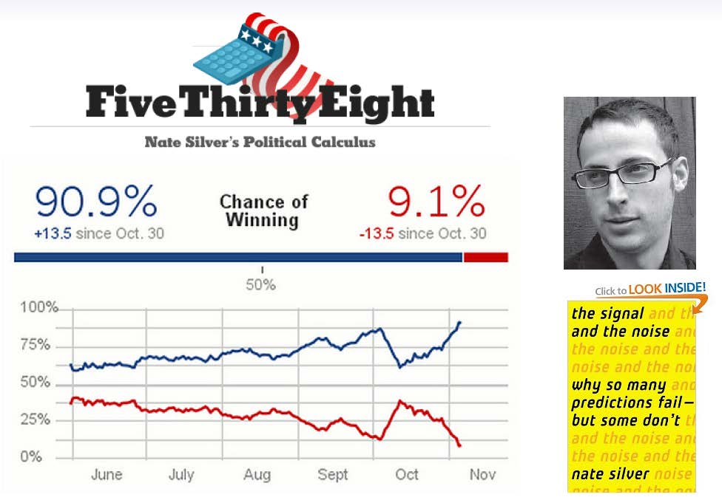
Data Science Social Science: Survey Sampling

Slide 23
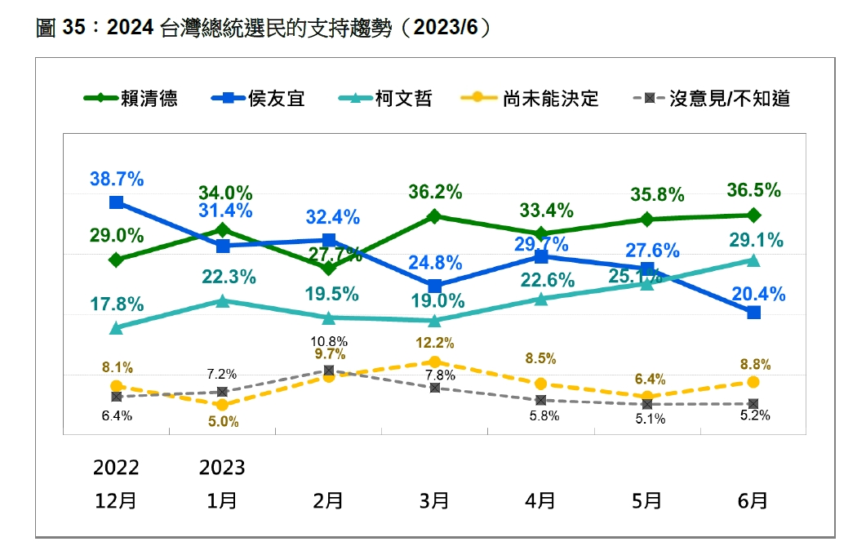
Data Science Social Science: Survey Sampling

Slide 24
Data Science Social Science: Survey Sampling

Slide 25
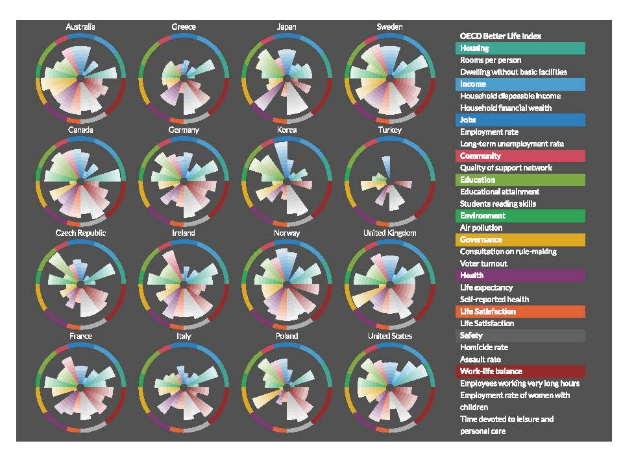
Data Science Social Science: Better Life Index Census or Sampling

Slide 26
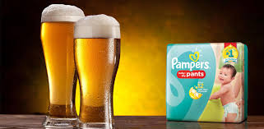
Data Source Business
A famous data mining market basket analysis example
Bear and Diaper: a myth or a parable….

Slide 27
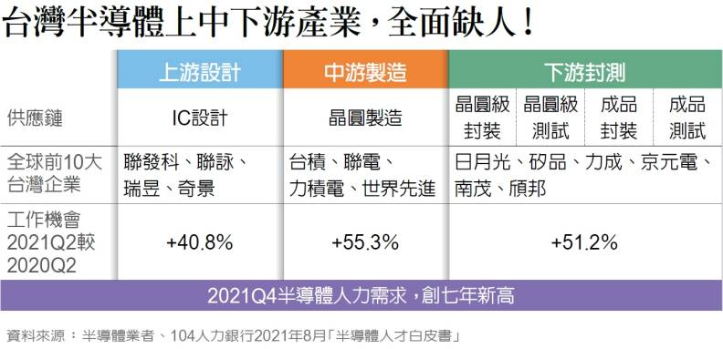
Data Source Industry: Semiconductor

Slide 28
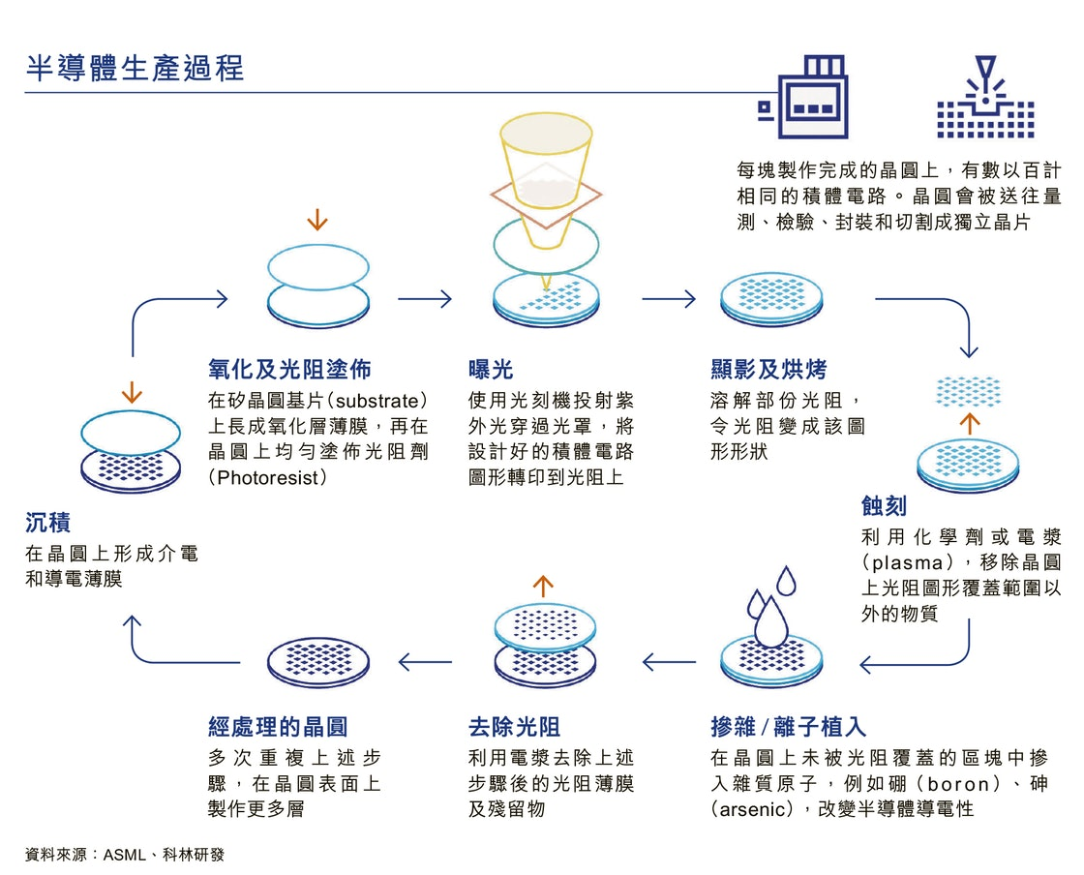
Data Source Industry: Semiconductor

Slide 29
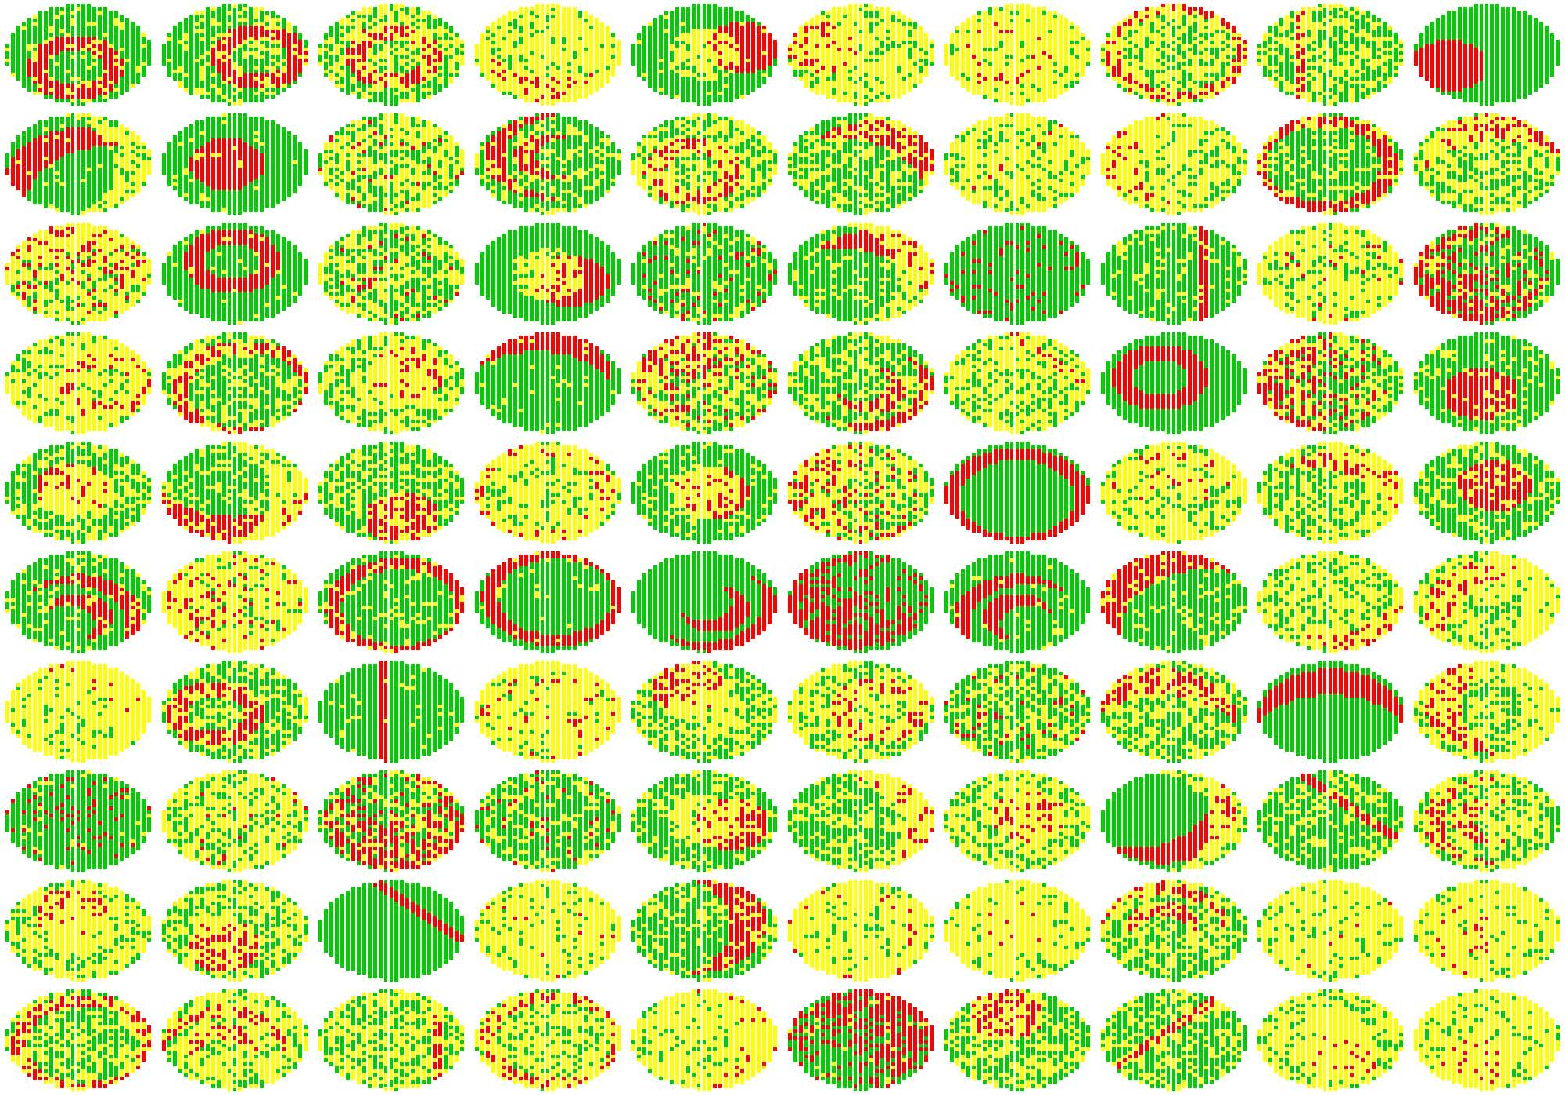
Data Source Industry: Semiconductor Wafer Bin Map

Slide 30
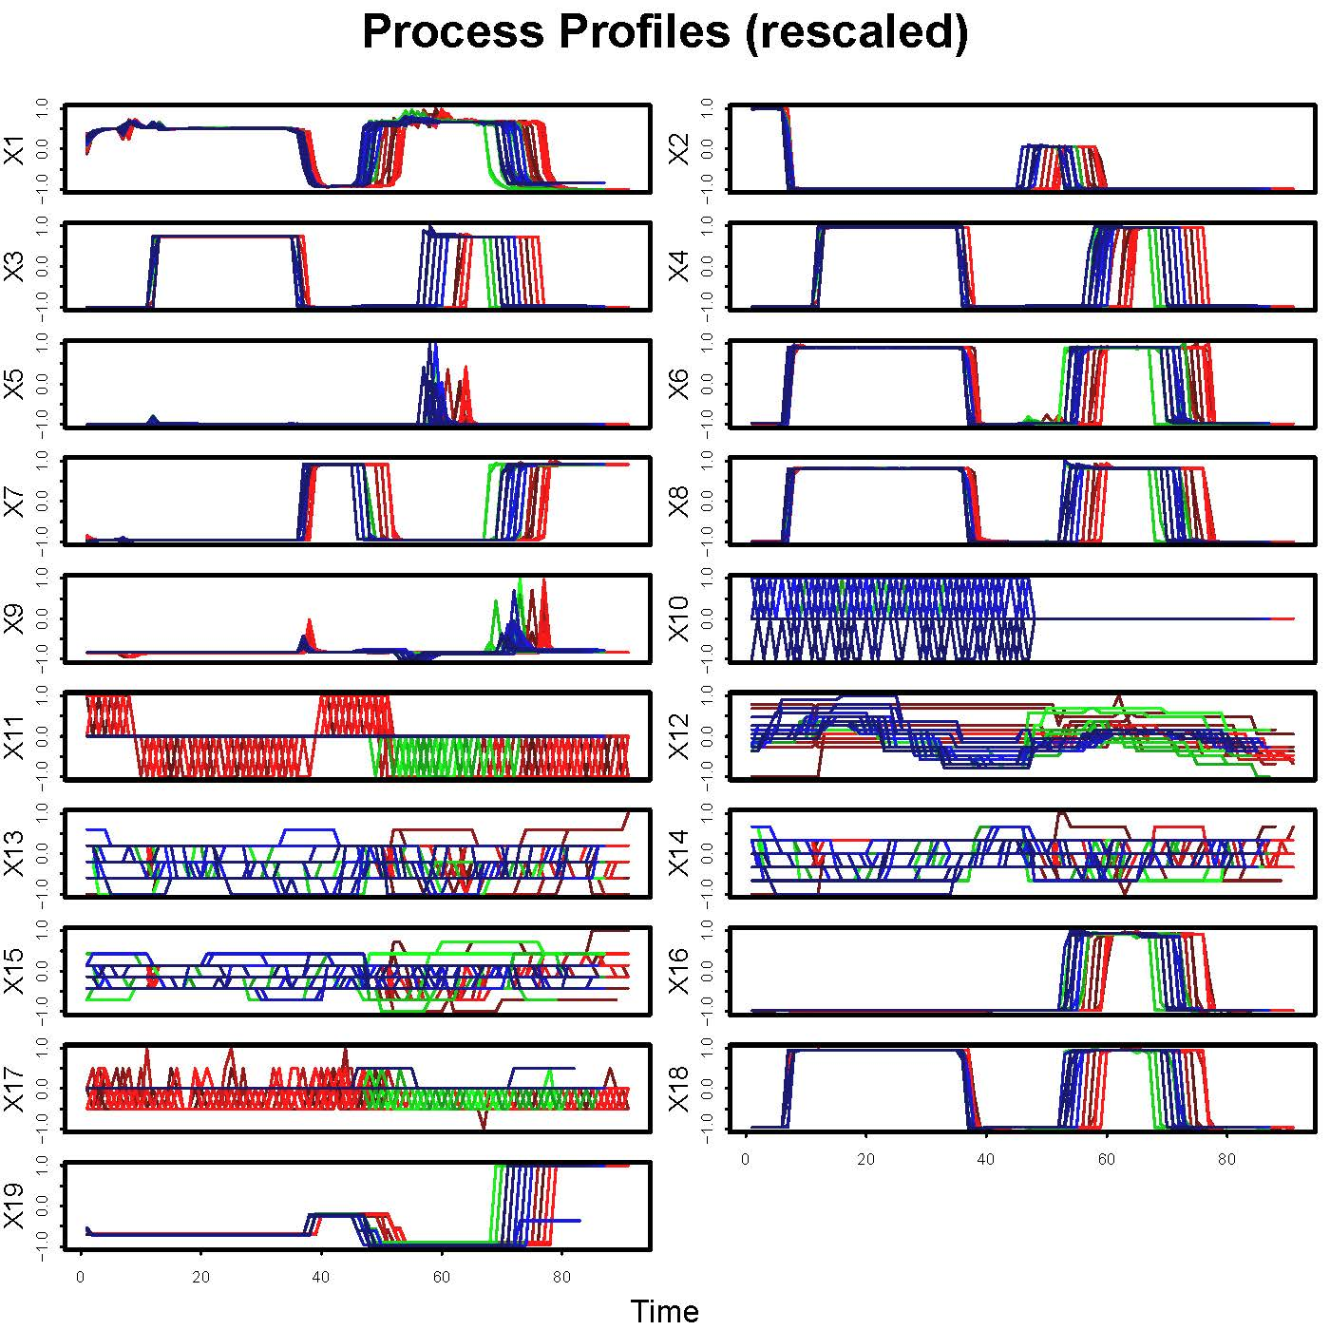
Data Source Industry: Semiconductor Process Profiles

Slide 31
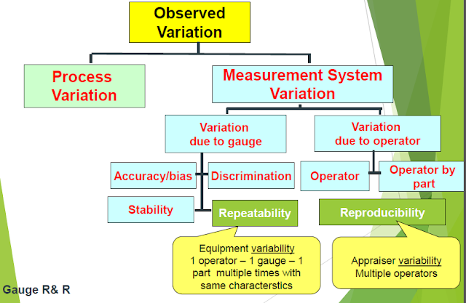
Data Source Industry: Measurement System

Slide 32
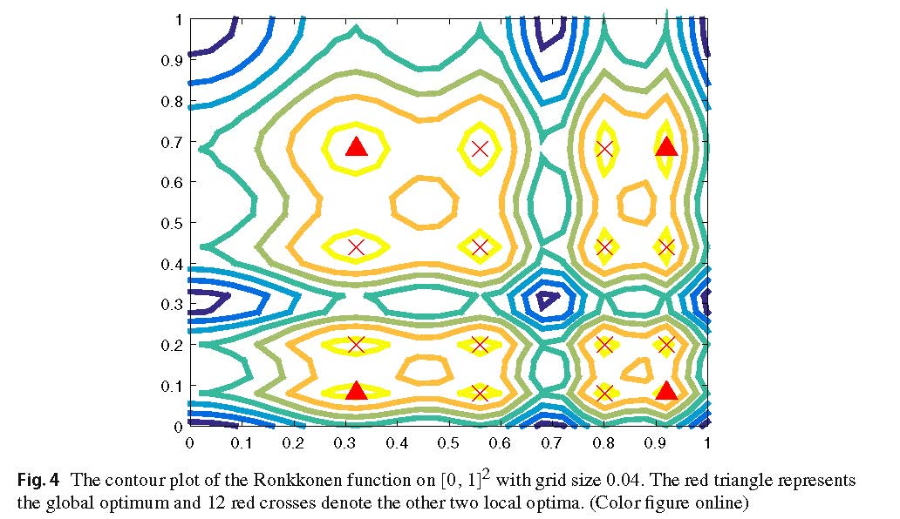

Data Source Industry: Optimum Design
Finding optimal points for expensive functions using
adaptive RBF-based surrogate model via uncertainty
quantification
Ray-Bing Chen1 · Yuan Wang2 · C. F. Jeff Wu3

Slide 33

Data Source Industry: Reliability

Slide 34
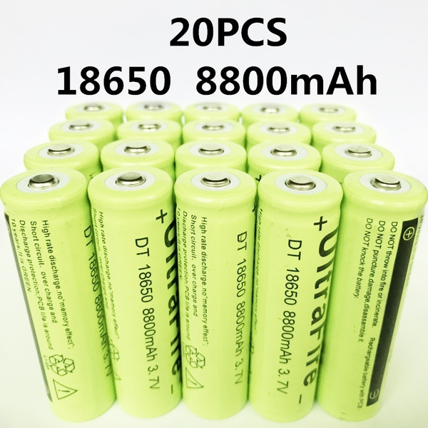
Data Source Industry: Battery Reliability
Tesla Model S/X cells arranged in a 74p6s=444 configuration, 444x16=7104 cells

Slide 35
Data Science Sports Predict Basketball Shooting

Slide 36


Data Science Sports Ping Pong Training and Coaching

Slide 37
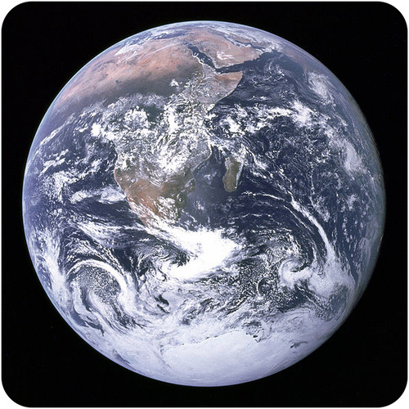

Earth Sciences and Astronomy

Slide 38
Earth Sciences and Astronomy

Slide 39
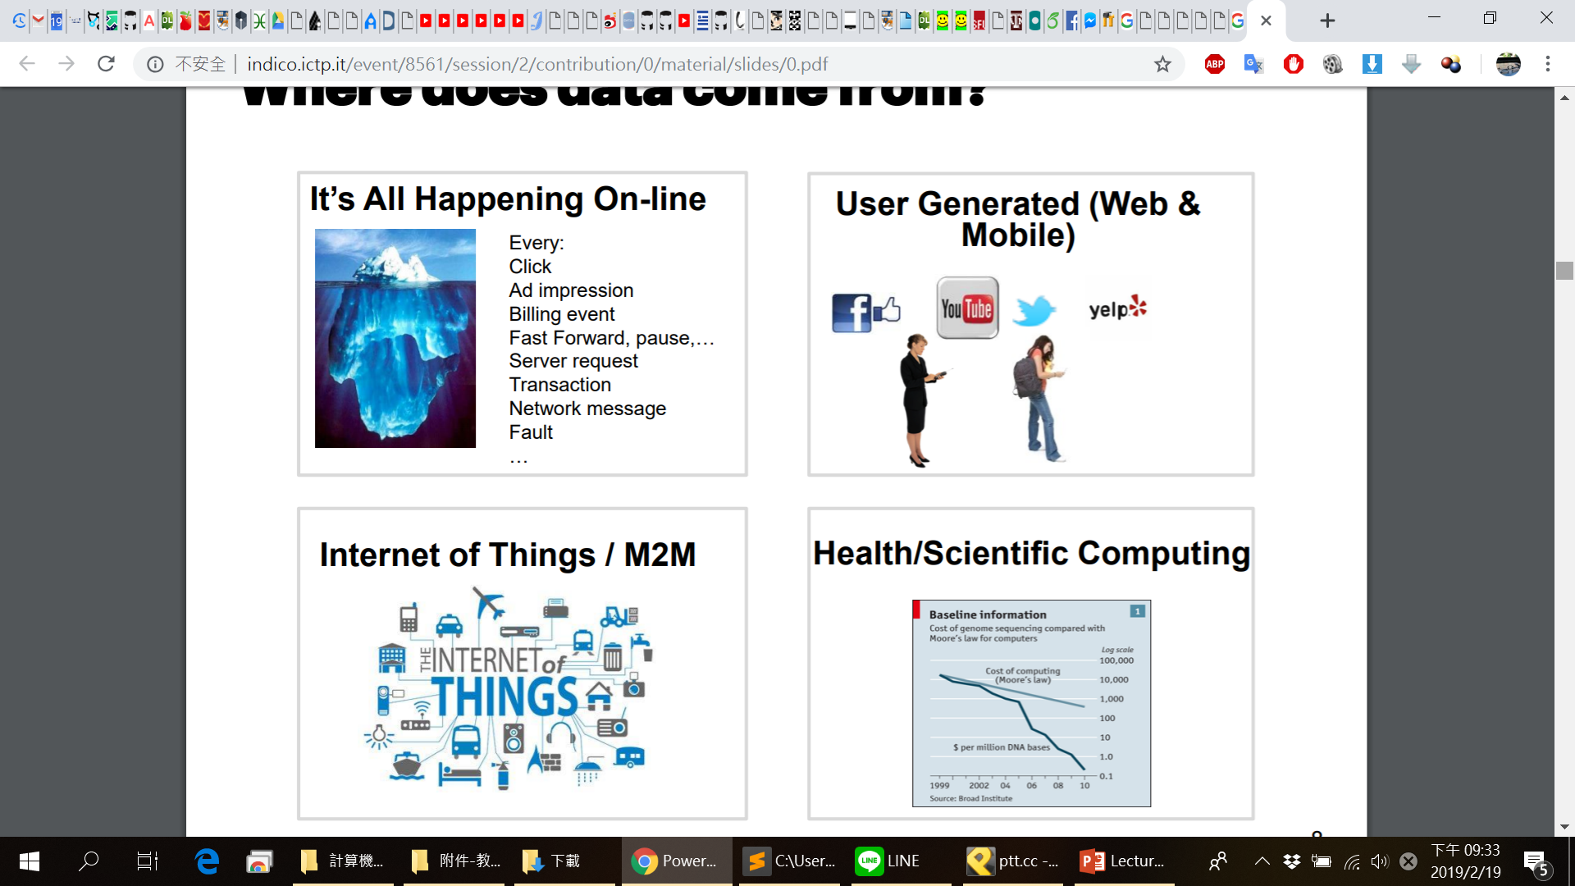
Web, Mobile and IoT

Slide 40
Data Source Web, Mobile Online Shops
http://www.tamaraberg.com/street2shop/
(Credit: Jia-Bin Huang)

Slide 41
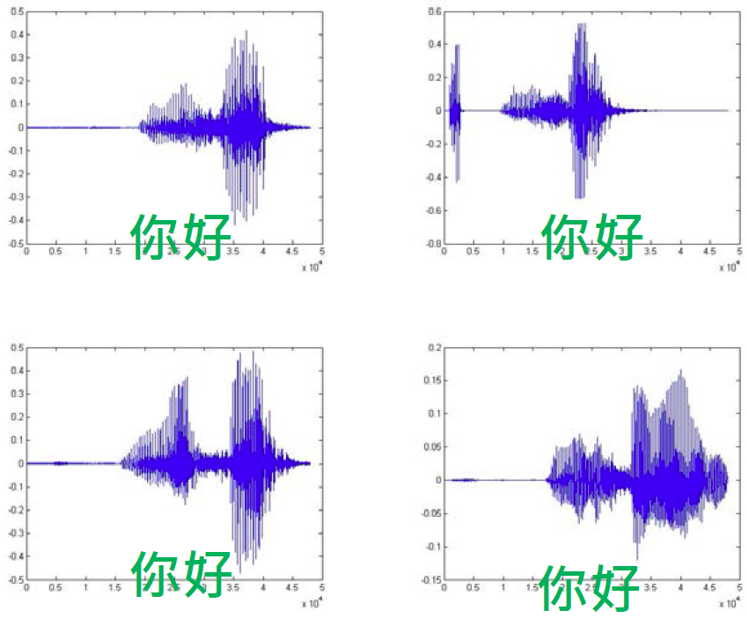

Data Source Mobile Audio Recognition in Siri
大家好
人帥真好
(Credit: Hung-Yi Lee)

Slide 42
Data Scientist
“The ability to take data — to be able to understand it, to process it, to extract value from it, to visualize it, to communicate it — that’s going to be a hugely important skill in the next decades.”
– Hal Varian, chief economist at Google and UC Berkeley professor of information sciences, business, and economics

Slide 43
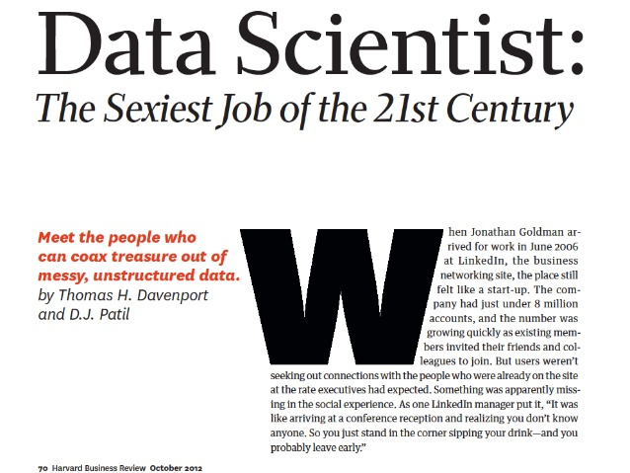

Slide 44
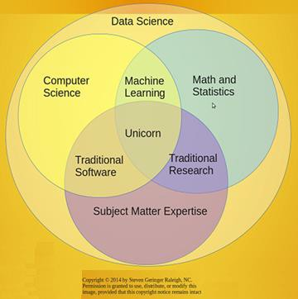
Data Science Content Raleigh

Slide 45

Data Science Content Michael Barber

Slide 46
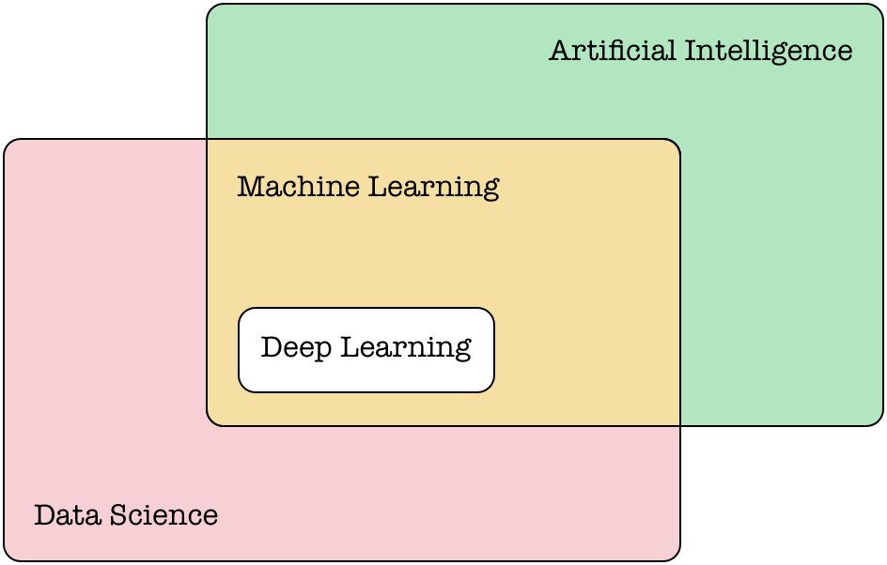
Data Science and AI

Slide 47
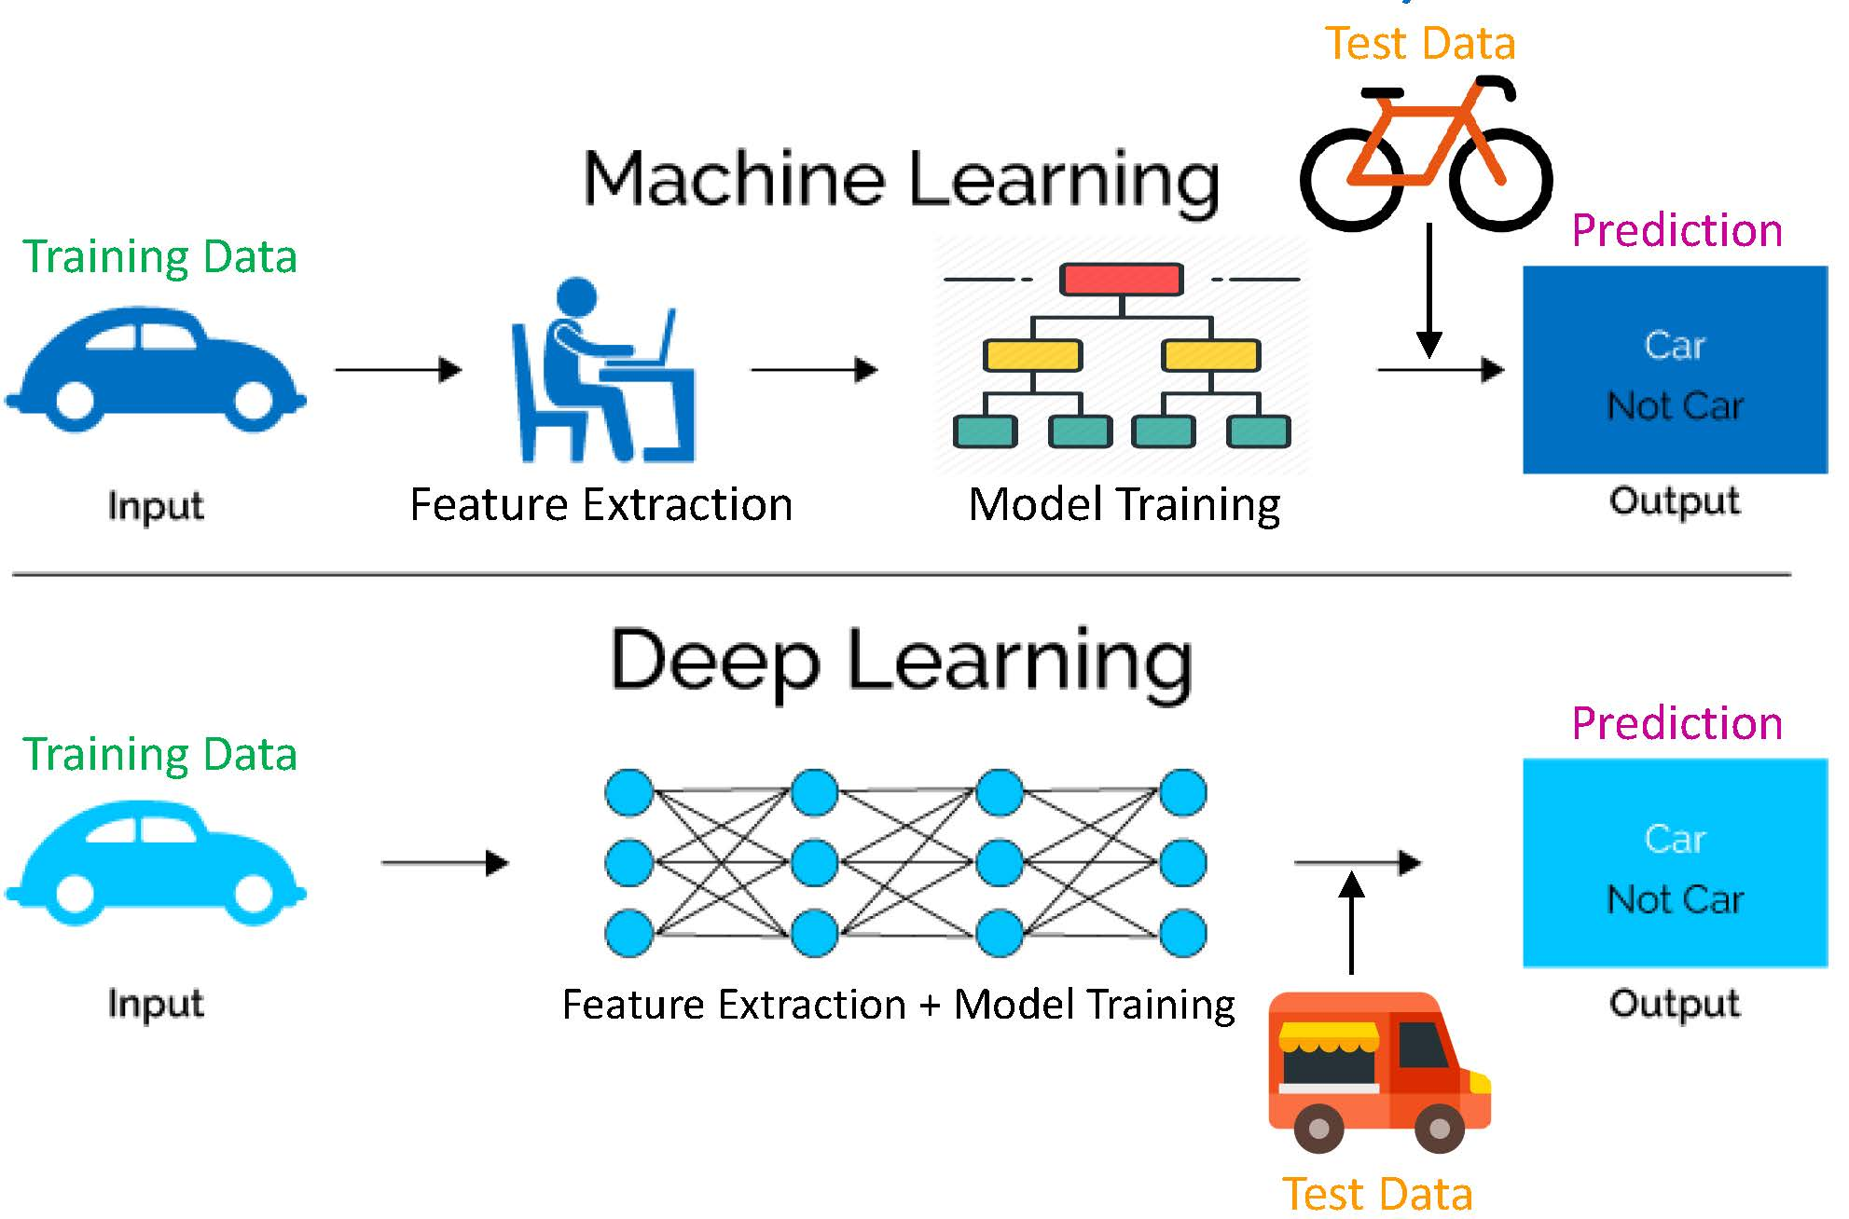
The Core of Data Science: ML/DL

Slide 48
Data Science Work Ben Fry’s Model
Acquire
Parse
Filter
Mine
Represent
Refine
Interact

Slide 49
Data Science Work Jeff Hammerbacher’s Model
1. Identify problem
2. Instrument data sources
3. Collect data
4. Prepare data (integrate, transform, clean, ﬁlter, aggregate)
5. Build model
6. Evaluate model
7. Communicate results

Slide 50
Data Science Courses Sandford University Department of Statistics
Statistics Data Science Curriculum
Students must demonstrate breadth of knowledge in the field by completing courses in these core areas.
Mathematical & Statistical Foundations (15 units)
Experimentation (3 units)
Scientific Computing (includes software development & large-scale computing) (6 units minimum)
Machine Learning Methods & Applications (6 units minimum)
Practical Component (3 units)
Elective course in the data sciences (remainder of 45 units)

Slide 51
Data Science Courses Harvard University Department of Statistics
The Data Science master's program, jointly led by the Computer Science and Statistics faculties
The four technical core courses:
AC 209a “Data Science 1: Introduction to Data Science”
AC 209b “Data Science 2: Advanced Topics in Data Science”
AM 207 “Advanced Scientific Computing: Stochastic Methods for Data Analysis, Inference, and Optimization”
AC 207 “Systems Development for Computational Science”
AC221 “Critical Thinking in Data Science”

Slide 52
Data Science Courses MIT Data Science Degree
Course | Title | Credits | Semester
CS 18000 | Problem Solving and Object-Oriented Programming | 4 | 1
CS 18200 | Foundations of Computer Science | 3 | 2
CS 38003 | Python Programming | 1 | 2
CS 24200 | Introduction to Data Science | 3 | 3
STAT 35500 | Statistics for Data Science | 3 | 3
CS 25100 | Data Structures & Algorithms | 3 | 4
STAT 41600 | Probability | 3 | 4
CS 37300 | Data Mining and Machine Learning | 3 | 5
STAT 41700 | Statistical Theory | 3 | 5
CS 49000 LSDA | Large Scale Data Analytics | 3 | 7
CS 49000 DSC | Data Science Capstone | 0-3 | 8

Slide 53
Data Science Courses Institute of Data Science NCKU
Core courses
Statistical Methods 3
Data Science 3
Machine Learning 3
Data Analysis in Practice
(Statistics Consulting) 3
最佳化方法Optimization Methods 3
Elective courses
Digital Image Processing and Computer Vision, High Frequency Financial Data Analysis, Data Visualization, Social and Information Network Analysis, Recommendation System, Deep Learning, Artificial Intelligence, Bioinformatics
Elective courses offered by the Institute of Statistics

Slide 54

Data Types

Slide 55
Data Types The Structure Spectrum
Structured (schema-first)
Semi-Structured (schema-later)
Unstructured (schema-never)
Relational Database
DocumentsXML
Plain Text
IoT, Log File
Tagged Text/Media
IoT
Formatted Messages
Media

Slide 56
Key Concept: Structured Data
A data model is a collection of concepts for describing data.
A schema is a description of a particular collection of data, using a given data model.

Slide 57
9 Top Programming Languages for Data Science May 24, 2021 / edX team
Python
R
SQL
Scala
Julia
Javascript
Java
C/C++
MATLAB
Bonus: Excel
edX is an American massive open online course (MOOC) provider created by Harvard and MIT.

Slide 58
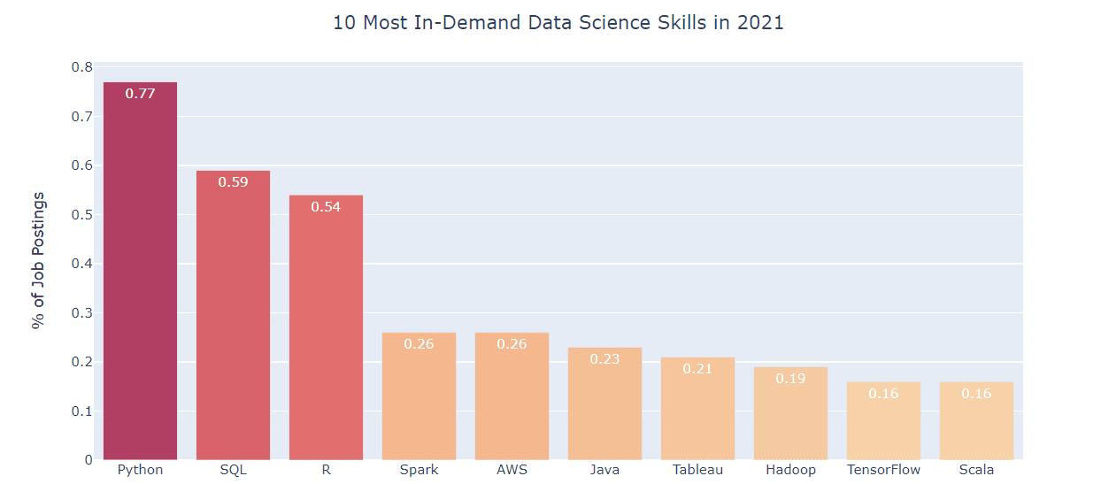
Technology Skills in 15000 Data Scientist Job Post Listings
https://www.kdnuggets.com/2021/04/most-demand-skills-data-scientists.html

Slide 59
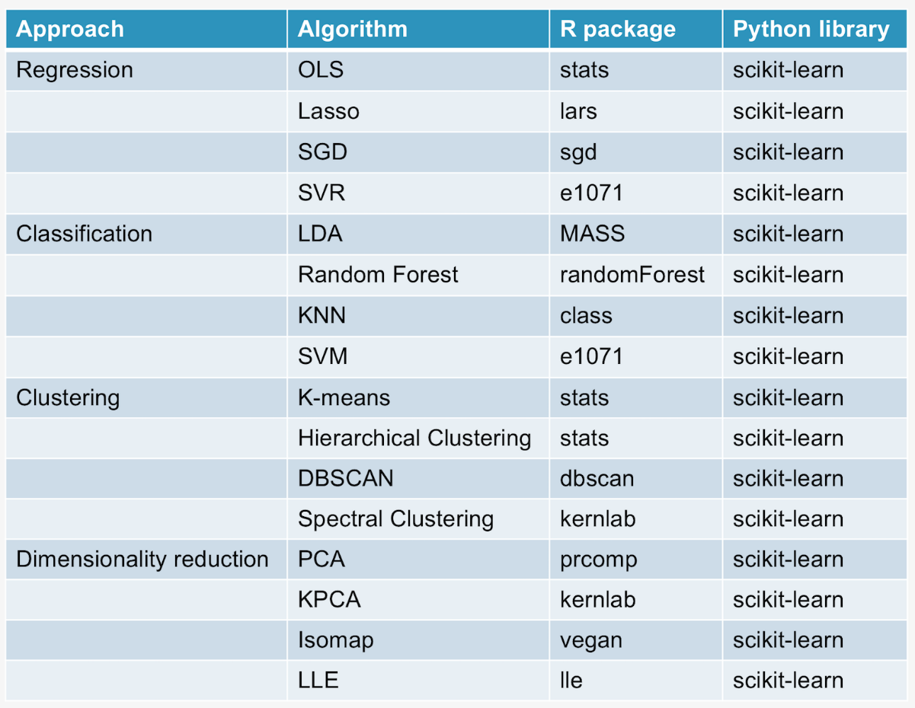
Python vs. R: Packages in Machine Learning

Slide 60
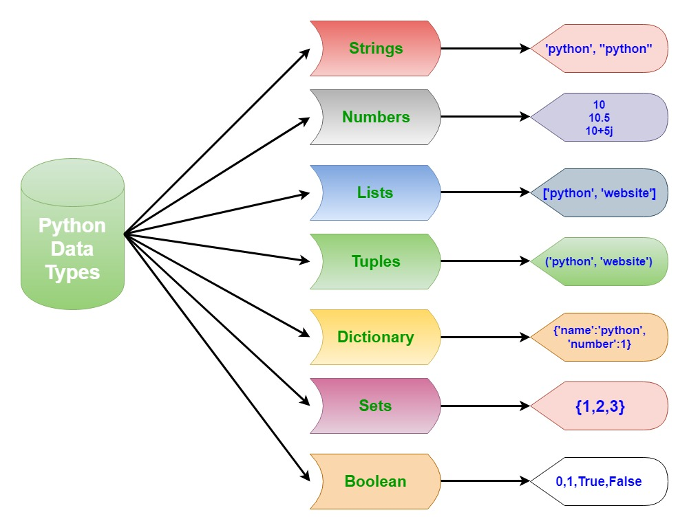
Python Data Types

Slide 61
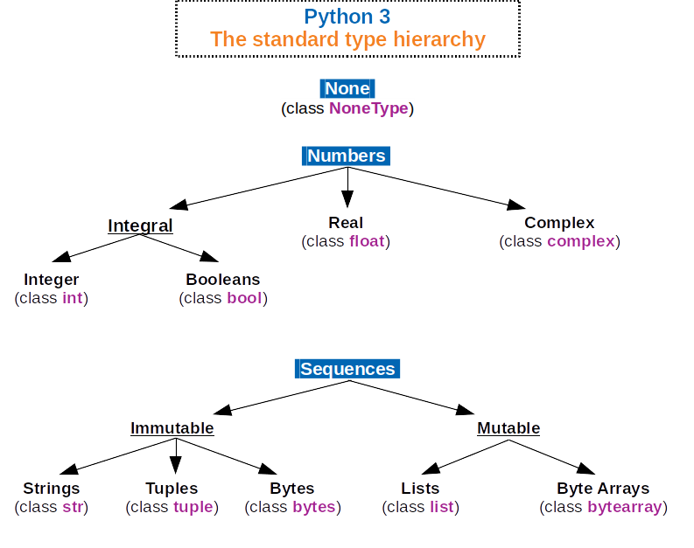
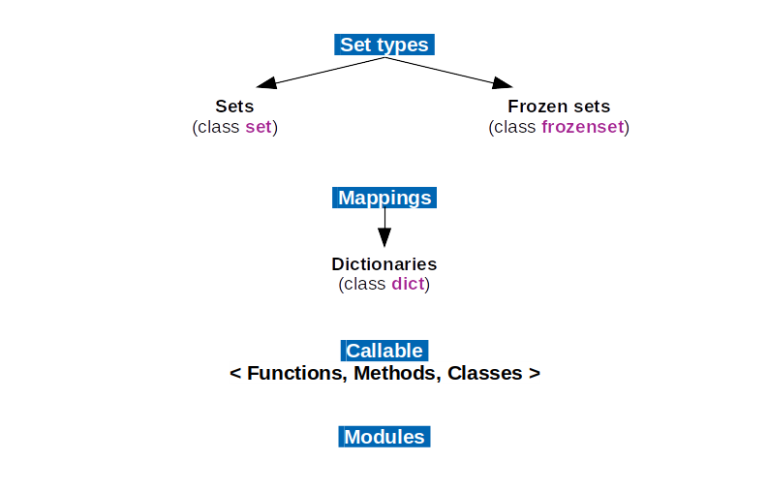
Python Data Types

Slide 62
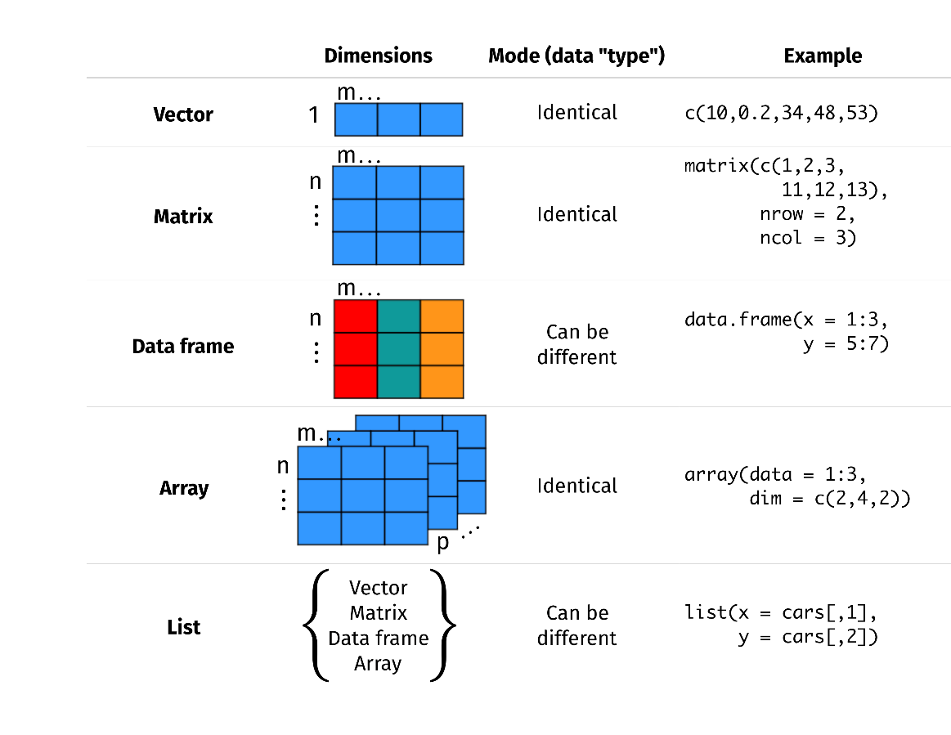
R Data Types

Slide 63
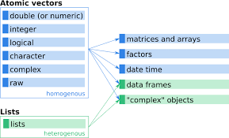
R Data Types

Slide 64
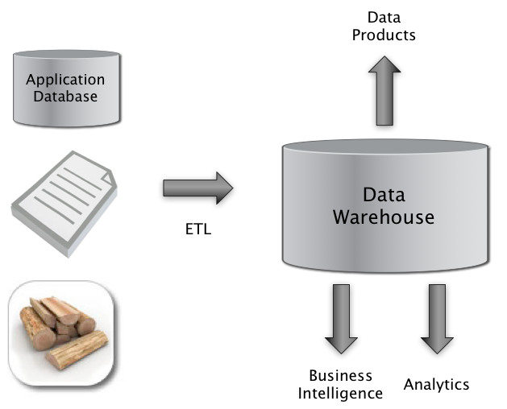
Data Storage extract, transform, and load

Slide 65
Data Storage
ETL
We need to extract data from the source(s)
We need to transform data at the source, sink, or in a staging area
We need to load data into the sink
Sources: file, database, event log, web site, HDFS…
Sinks: Python, R, SQLite, RDBMS, NoSQL store, files, HDFS…

Slide 66
Data Storage
Business Person: Excel
Programmer: Flat files
Enterprise: Teradata, Oracle, IBM DB2, Microsoft SQL Server
Web Company: Hadoop/Hive, Spark/Shark

Slide 67
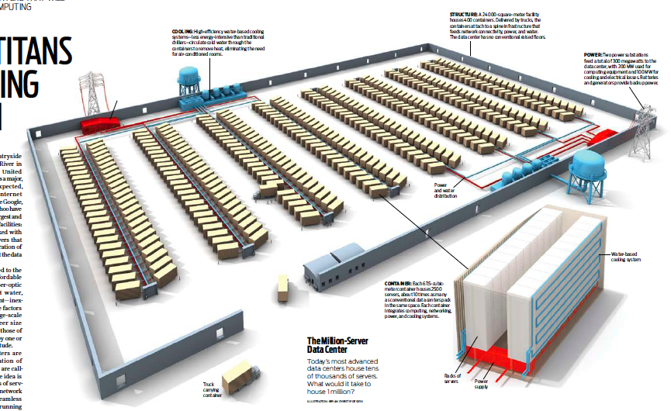
Data Storage

Slide 68
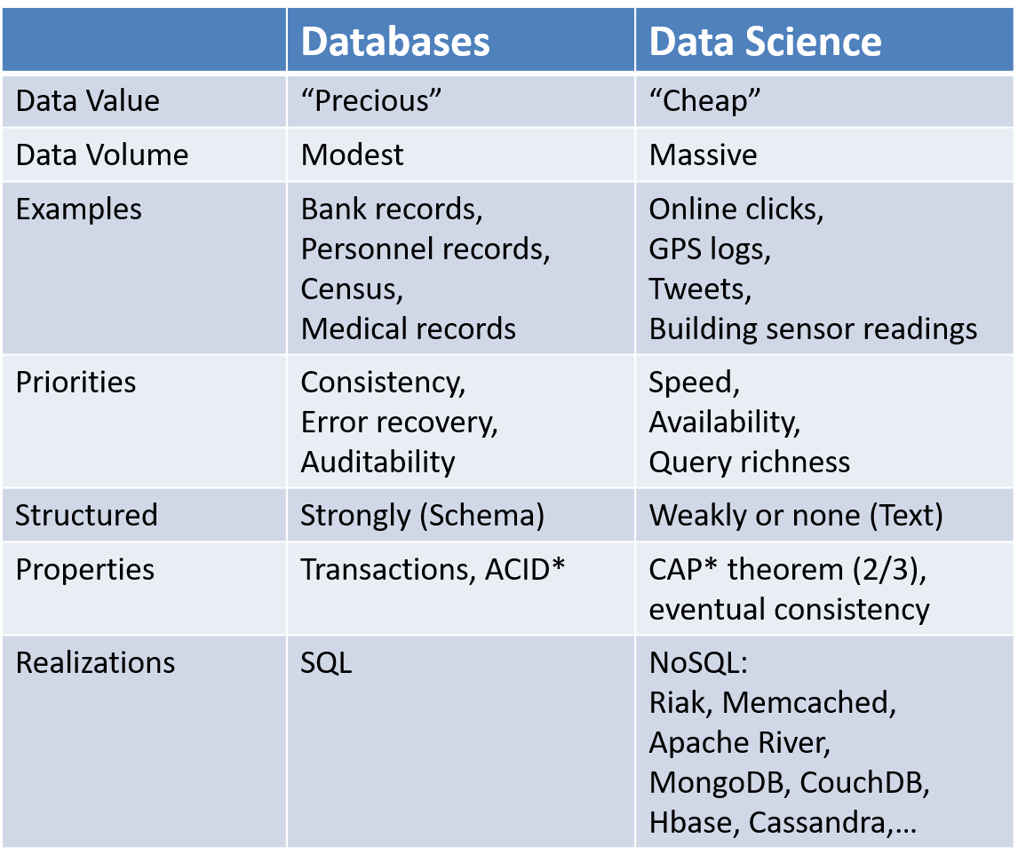
Contrast: Databases

Slide 69
Reference 1. Some Slides from Prof. Cheng-Te Li 2. Introduction to Data Science, Computer Science CS194 in Berkey University 3. Fan et al. 2021. Statistical Foundations of Data Science.

